Slide 1




Stock Market Prediction with LSTM
JOSTEIN BARRY-STRAUME
November 27, 2020

Slide 2
What is the problem?

Slide 3
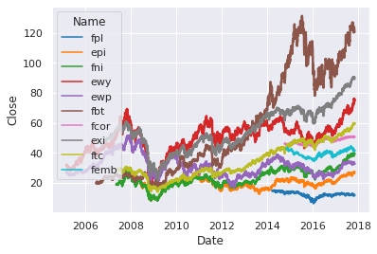

What is the problem?
Train a LSTM neural network to predict if a stock will move up or down
Notes:
Diagnostically benchmark and evaluate a various amount of Long-Short-Term-Memory (LSTM) neural networks, to forecast time series data such that the future direction of a given stock or exchange-traded fund (ETF) can be predicted reliably.

Slide 4
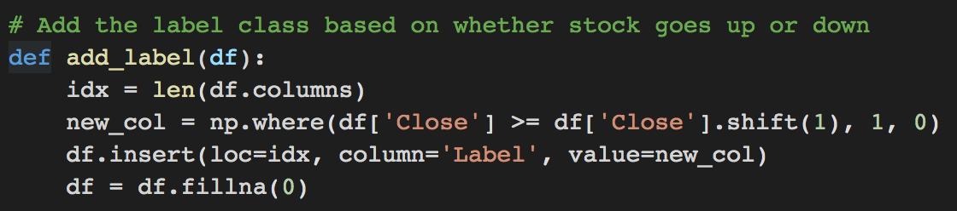
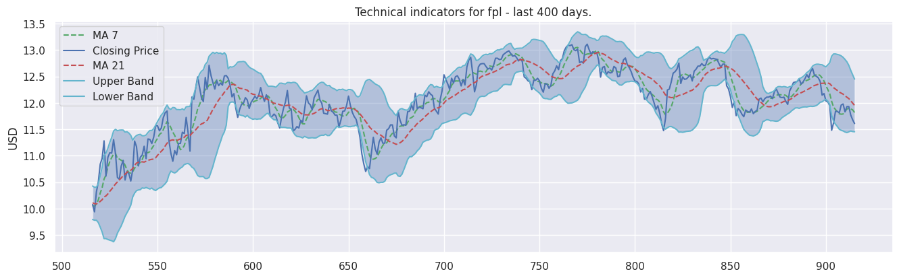
What is the problem?
Task:
Supervised learning
Performance Measure:
Validation Accuracy
Learning Component:
Technical Indicators
Notes:
Task:
I believe this term project would be classified as a supervised learning problem. In other words, I am predicting results within a continuous output, which maps input variables to a continuous function. In this situation, the input variables are the four basic daily information columns given as a stock’s open, close, high, and low values for the day. From here, more nuanced technical indicators are calculated as further input variables. Moreover, the output variable would be the stock’s closing price where time t = i + 1. I am modelling this behavior by creating a binary label that captures if the stock held or increased versus decreased compared to the previous day.
Performance measure:
The performance measure for this project is validation accuracy. I am looking to see how accurate a model can correctly predict which way a stock or ETF will move. Although this is a very basic performance measure, it is one of the most necessary to determine if I have a well performing model. In the future, I hope to implement a couple other performance measures into my model evaluation, which I will talk about in the later sections of this presentation.
Learning component:
The learning component of this problem would be the technical indicators of a given stock or ETF. Specifically, the model will learn and implicitly adjust the weights for the stock’s technical indicators based on a lookback window of time. For example, one ETF had 916 days of financial history. The first 800 days were used as a lookback window. Then the last 116 days were used to validate the performance of the learning components.

Slide 5

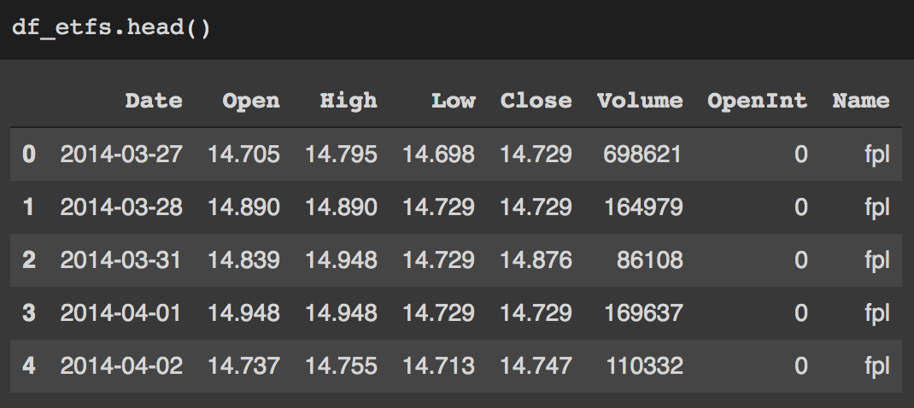
Data Background
NASDAQ stocks and ETFs
Historical data up until 04/01/2020
Data Size: 3GB
Notes:
Data background:
I will be using the Stock Market Dataset available on Kaggle: https://www.kaggle.com/jacksoncrow/stock-market-dataset
The total size of the dataset folder is 3GB. Historical pricing information for all NASDAQ stocks and ETFs contained in this dataset stops on April 1st, 2020. While this captures some of the turbulence the stock market went through at the beginning of this year, it is unclear at this time if I need to collect more data. If that is the case, the data collection script is provided to re-run and capture the most up-to-date information.
The structure of the data is as follows. Each stock ticker is saved as a CSV file with the following fields as shown on this slide's figure.
Date: The day of trading
Open: The opening price of the stock
High: The highest price of the stock for a given day
Low: The lowest price of the stock for a given day
Close: The closing price of the stock for a given day
Adj Close: The closing price adjusted to include dividends and stock splits
Volume: The quantity of trading between buyers and sellers that occurred on a given day

Slide 6
Why is it an important problem?

Slide 7

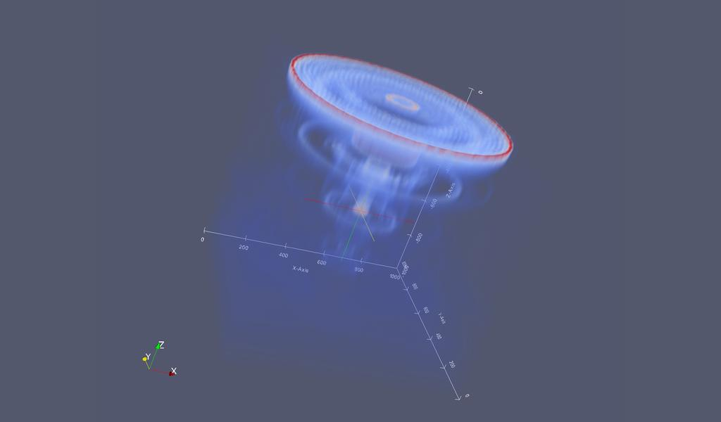
Motivation
Lab research
Career
Personal interest
Notes:
Why is it an important problem? [Motivation]
Being a part of the Computational Science Laboratory with Dr. Adrian Sandu, I am expected to help with applying machine learning algorithms towards problems involving time series analysis. While not directly related there is still some overlap that I can use as transfer learning.
Part of my long-term career goals involves working as a financial quantitative analyst. Working directly with financial data would go a long way towards having a project portfolio that aligns with what firms are looking for.
Personally, I also just have an interest in investing. However, portfolios less than $20,000 – 25,000 are often restricted to a given amount of “day trades.” Violating this limit can invoke temporary pauses on trading with said account. To get around this, I am targeting strategies that involve at least a 24-hour holding period.
Many of the top investment firms like to hire graduate students involved with computational modeling in rules-based constrained environments (e.g. physics based modeling of air quality). This is because it translates well to financial modeling.
high performance computing, and parallel optimization. Unfortunately, the current project is outside the scope of this class and I feel it would not be a good fit with regards to timely deliverables. With that in mind, I think starting with a Kaggle dataset is a good way to “shake off the cobwebs” and establish a good foundation such that I can ramp up to speed in assisting with research more swiftly.

Slide 8
Related work

Slide 9
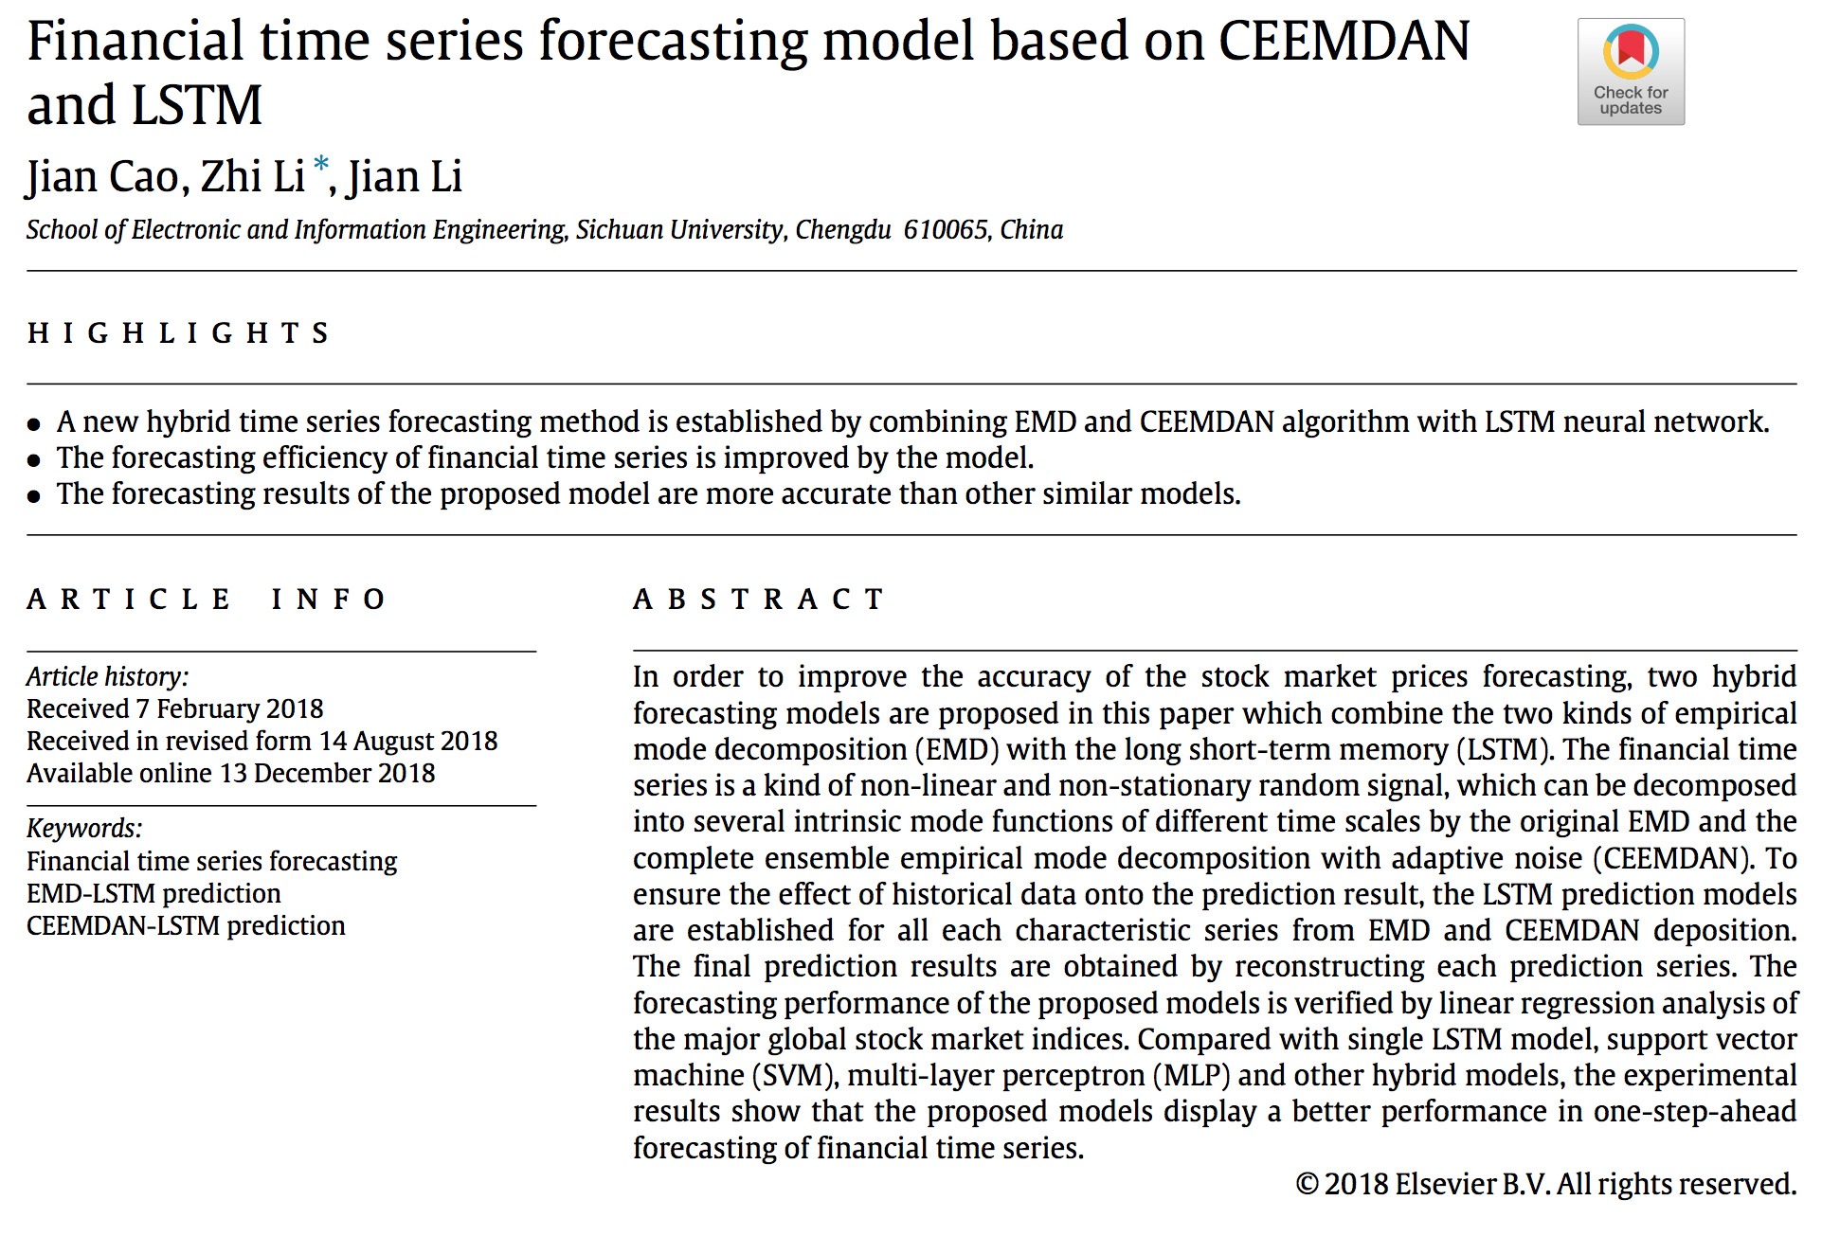
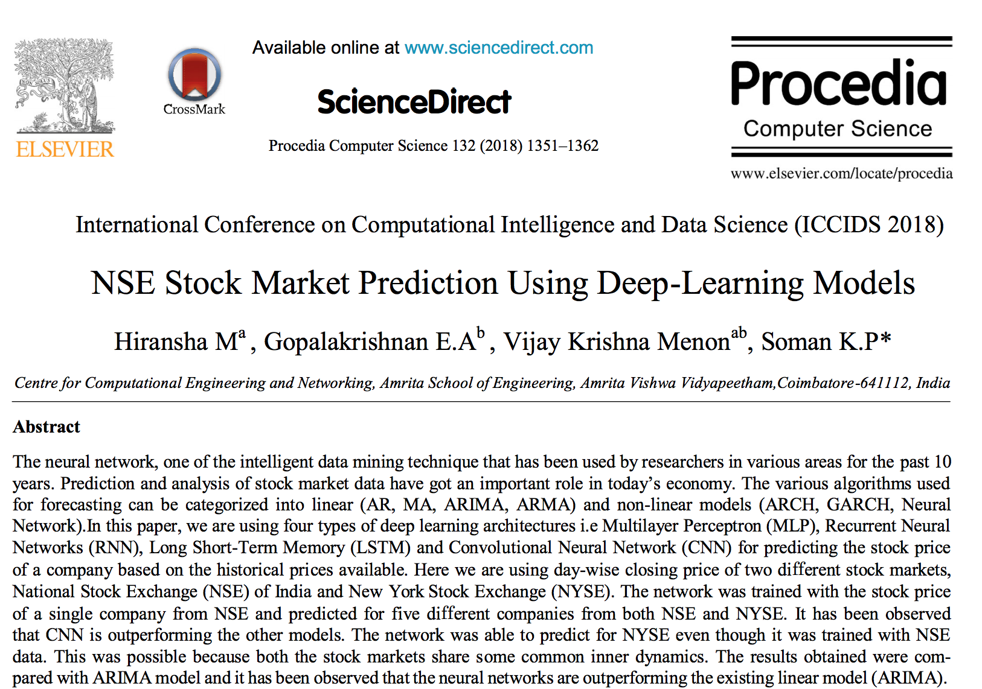
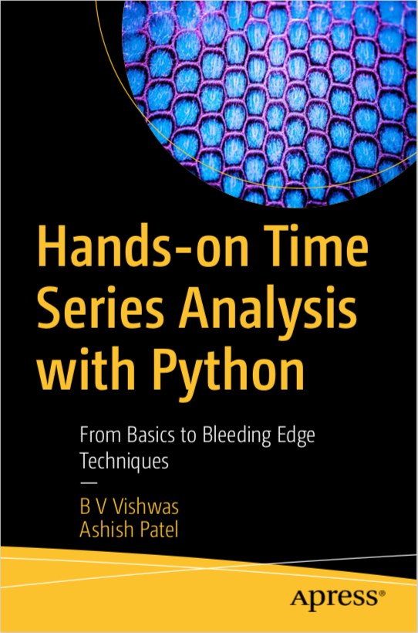
Literature Review
Many articles cover implementing hybrid ML models. Not the most helpful for a limited scope class project
Books, API documentation, and Keras tutorial examples so far have been the most helpful for both understanding and implementing concepts

Slide 10
Techniques chosen and why

Slide 11
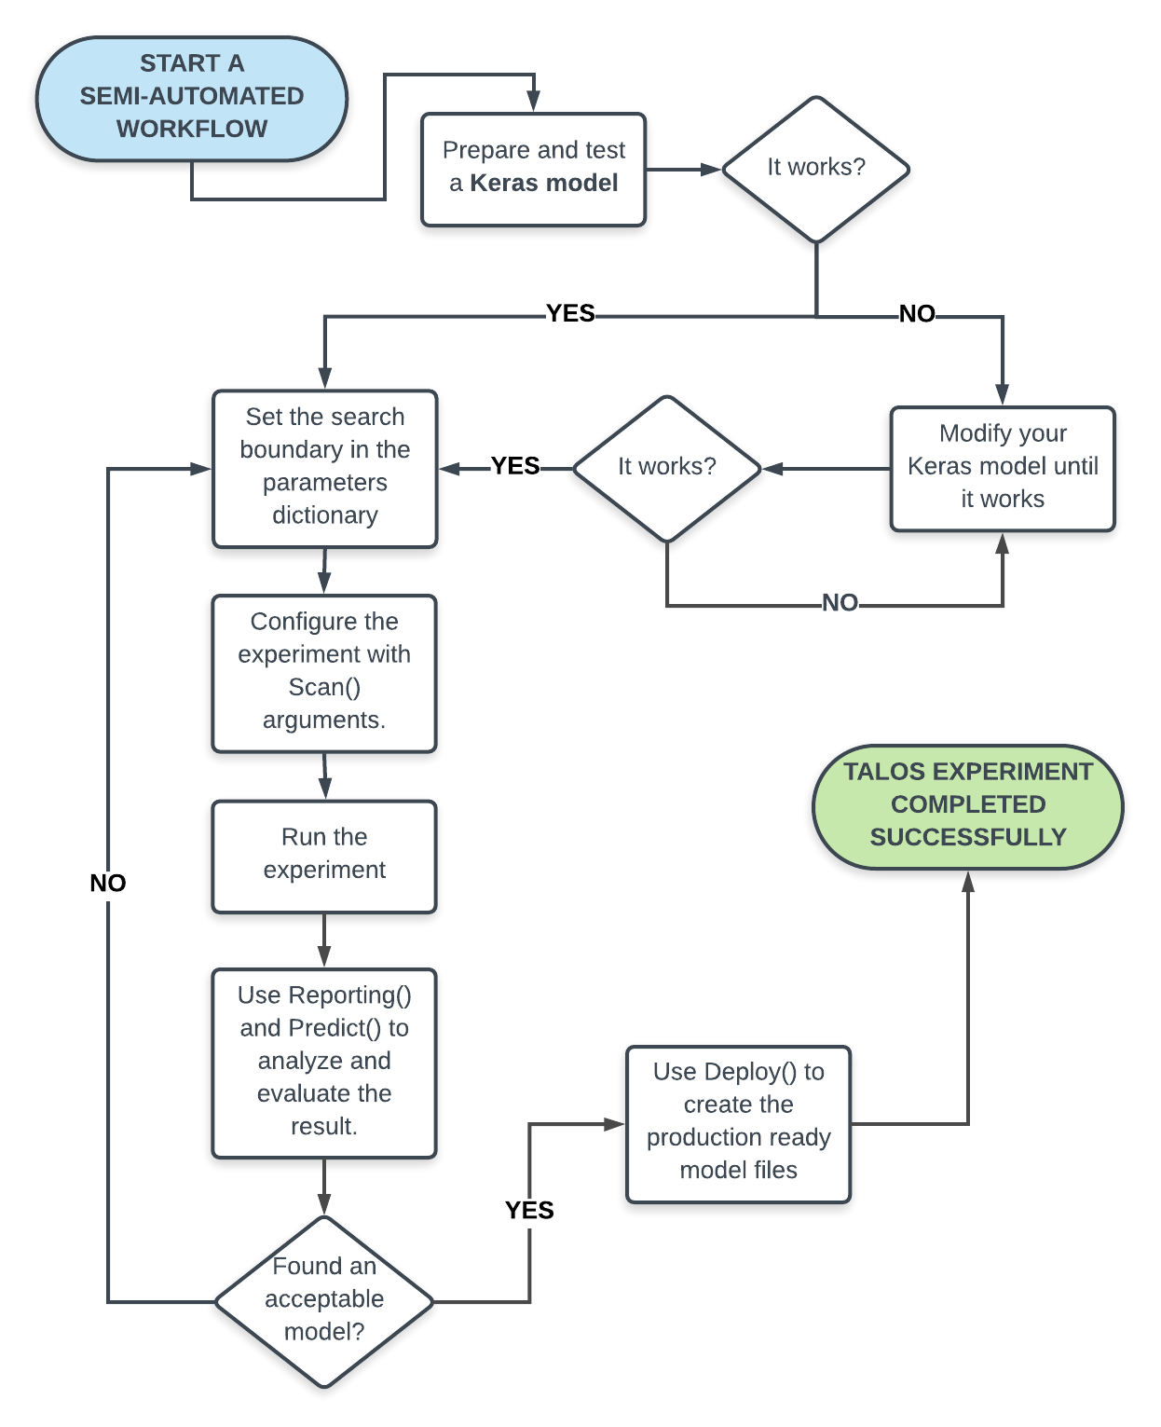
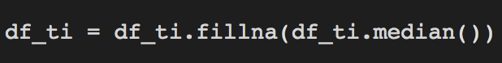
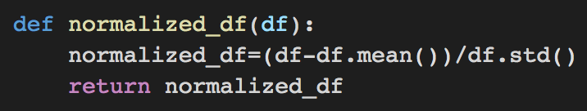
Techniques to tackle problem
Feature creation
Data imputation
Data normalization
Automated hyper-parameter tuning
Notes:
I calculated various technical indicators to better inform the LSTM model of the stock’s “momentum.” 7 and 21 day moving average. Moving average convergence divergence. Bollinger bands. Exponential moving average. Momentum. And 14 day Relative Strength Index (RSI).
I chose LSTM because it works well with time series data, both conceptually and in actuality. Moreover, there is an abundance of resources available online for LSTM models versus say trying to implement a genetic algorithm. With the limited time frame I have had to work on this project this semester, it seemed to be the wiser choice to go with a tried and true technical strategy for deliverable sake.

Slide 12
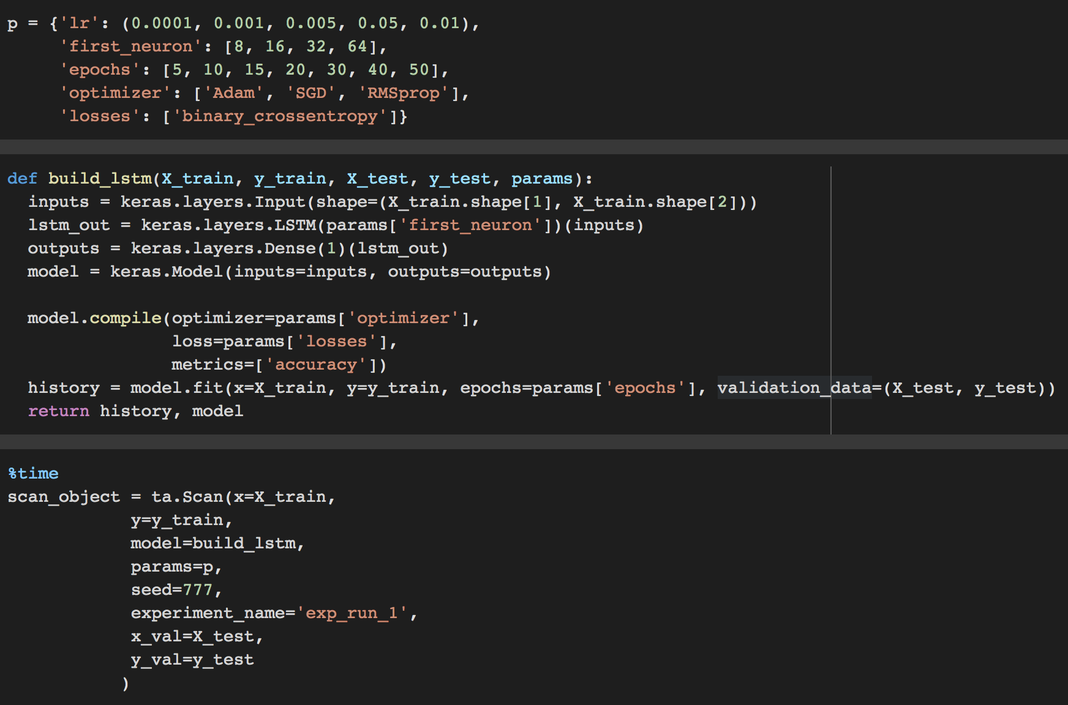
Talos API
Set parameters to test
Build model to specs
“Scan” all parameter permutations
“Report” each model’s performance
Notes:
I calculated various technical indicators to better inform the LSTM model of the stock’s “momentum.” 7 and 21 day moving average. Moving average convergence divergence. Bollinger bands. Exponential moving average. Momentum. And 14 day Relative Strength Index (RSI).
I chose LSTM because it works well with time series data, both conceptually and in actuality. Moreover, there is an abundance of resources available online for LSTM models versus say trying to implement a genetic algorithm. With the limited time frame I have had to work on this project this semester, it seemed to be the wiser choice to go with a tried and true technical strategy for deliverable sake.

Slide 13
Empirical evaluation

Slide 14
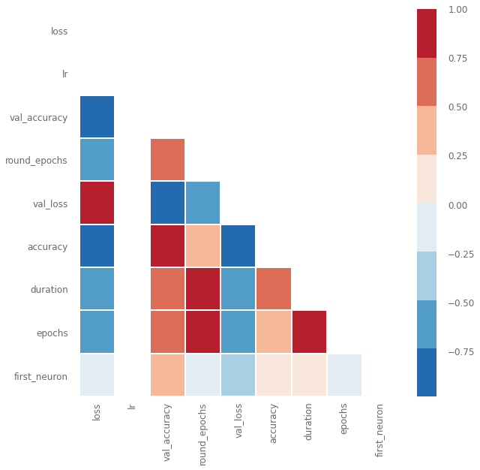
Visualizing Relationships
Validation Accuracy has strong, positive correlations with:
Number of neurons
Epochs
Duration of training
Round of epoch training

Slide 15
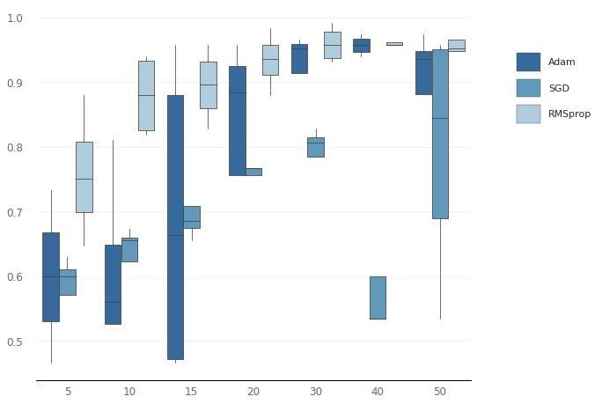
Validation Accuracy
Distribution of Optimizers
Overall distribution trend is logarithmic
As epochs increase (x-axis), val acc increases
Adam has largest variance
RMSprop has smallest variance

Slide 16
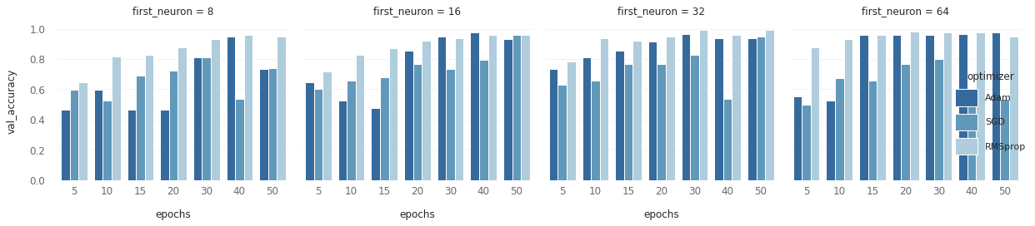
4 Dimensional Bar Grid
Breaks down validation accuracy for each neuron density by epochs per each optimizer
RMSprop performs consistently better in each neuron density
SGD seems to struggle at highest neural density; perhaps overfitting?

Slide 17
Conclusion

Slide 18
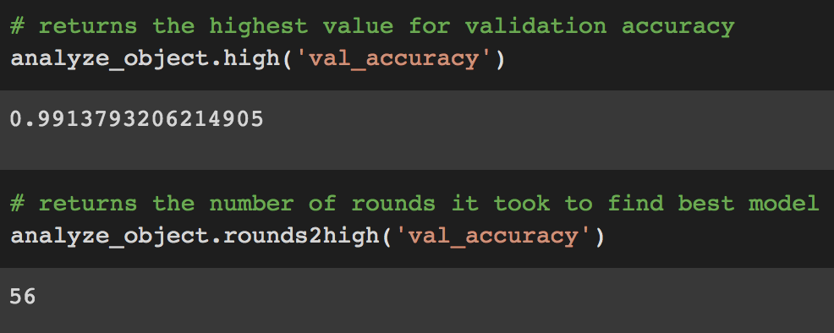
Best Model
84 different models trained
Best model:
Found at round 56 of 84
Validation accuracy: 99.14%
Round | Val Acc | LR | Epochs | Optimizer | Neural Density
56 | 99.14% | 0.0001 | 50 | RMSprop | 32
Notes:
What is the best technique?
Is any technique good enough to declare the problem solved? Problem by no means solved, expecting to solve stock market predictions via a class project is overly ambitious. Could this be useful for developing a production level model in the real world? I hope so and I’m eager to find out.
What future research do you recommend?

Slide 19
Questions?

Slide 20


